Slide 1
Ch 8 Classification Basic Concepts

Slide 2
8.1.2 Classification
Data classification is a two step process, consisting of a learning step (where a classification model is constructed) and a classification step (where the model is sued to predict class labels for given data).

Slide 3
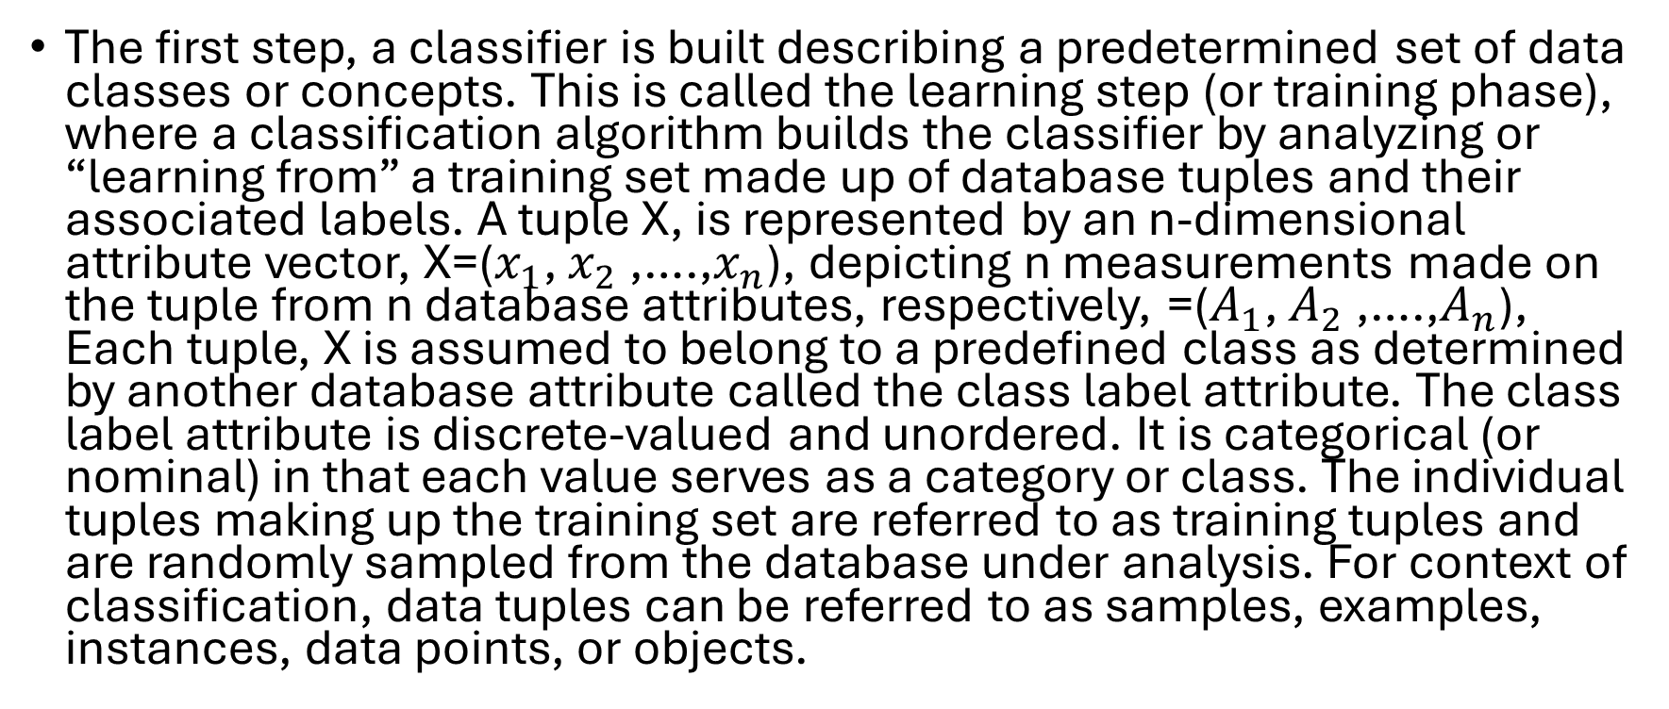
Learning Step (or training phase)
The first step, a classifier is built describing a predetermined set of data classes or concepts. This is called the learning step (or training phase), where a classification algorithm builds the classifier by analyzing or “learning from” a training set made up of database tuples and their associated labels. A tuple X, is represented by an n-dimensional attribute vector, X=($x_{1}$, $x_{2}$ ,….,$x_{n}$), depicting n measurements made on the tuple from n database attributes, respectively, =($A_{1}$, $A_{2}$ ,….,$A_{n}$), Each tuple, X is assumed to belong to a predefined class as determined by another database attribute called the class label attribute. The class label attribute is discrete-valued and unordered. It is categorical (or nominal) in that each value serves as a category or class. The individual tuples making up the training set are referred to as training tuples and are randomly sampled from the database under analysis. For context of classification, data tuples can be referred to as samples, examples, instances, data points, or objects.

Slide 4
Also known as supervised learning
Because the class label of each training tuple is provided, this step is also known as supervised learning (i.e. the learning of the classifier is “supervised” in that it is told to which class each training tuple belongs). It contrast with unsupervised learning (or clustering) in which the class label of each training tuple is not known, and the number have the loan_decision data available for the training set, we could use clustering to try to determine “groups of like tuples” which may correspond to risk groups within the loan application data.

Slide 5
Classifcation can also be viewed as mapping of function y=f(X)
The function y=f(X) can predict the associated class label y of a given tuple X.
In this view, we wish to learn a mapping or function that separates the data classes. Typically, this mapping is represented in the form of classification rules, decision trees, or mathematical formulae.
Within our example, the mapping is represented as classification rules that identify loan applications as either being safe or risky. The rules can be used to categorize future data tuples, as well as provide deeper insight into the data contents. They also provide a compressed data representation.

Slide 6
The second step is Classification accuracy
First, the predictive accuracy of the classifier is estimated. If we were to use the training set to measure the classifier is estimated. If we were to use the training set to measure the classifiers accuracy, the estimate would likely be optimistic, because the classifier tends to overfit the data (i.e. during learning it may incorporate some particular anomalies of the training data that are not present in the general data set overall.) Therefore, a test set is used, made up of test tuples and their associated class labels.
They are independent of the training tuples, meaning that they were not used to construct the classifier.

Slide 7
The accuracy of a classifier
The accuracy of a classifier on a given test set is the percentage of test set tuples that are correctly classified by the classifier.
The associated class label of each test tuple is compared with the learned classifier’s class prediction for that tuple.
If the accuracy of the classifier is considered acceptable, the classifier can be used to classify future data tuples for which the class label is not known. (Such data are also referred to in the machine learning literature as “unknown” or “previously unseen” data).

Slide 8
Ch 8.2 Decision Tree Induction
Decision tree induction is the learning of decision trees from class-labeled training tuples.
A decision tree is a flowchart-like tree structure, where each internal node (non-leaf node) denotes a test on an attribute, each branch represents an outcome of the test, and each leaf node (or terminal node) holds a class label. The topmost node in a tree is the root node.
This was covered in your data structures and algorithms course but it is when the program asks a question and makes a decision based on that question, and continues going until the nodes run out

Slide 9
Now how are decision trees used for classification?
Given a tuple, X, for which the associated class label is unknown, the attribute values of the tuple are tested against the decision tree.
A path is traced from the root to a leaf node, which holds the class prediction for that tuple. Decision trees can easily be converted to classification rules.
“Why are decision tree classifiers so popular?” The construction of decision tree classifiers does not require any domain knowledge or parameter setting, and therefore is appropriate for exploratory knowledge discovery. Decision trees can handle multidimensional data.

Slide 10
Now how are decision trees used for classification?
Their representation of acquired knowledge in tree form is intuitive and generally easy to assimilate by humans. The learning and classification steps of decision tree induction are simple and fast. In general, decision tree classifiers have good accuracy.
However, successful use may depend on the data at hand. Decision tree induction algorithms have been used for classification in many applications areas such as medicine, manufacturing/production, financial analysis, astronomy, and molecular biology.
Decision trees are the basis of several commercial rule induction systems

Slide 11
Ch. 8.2.1 Decision Tree Induction
During the late 1970s and early 1980s, J. Ross Quinlan, a researcher in machine learning developed a decision tree algorithm known as ID3 (Iterative Dichotomiser). This work expanded on earlier work on concept learning systems, described by E.B. Hunt J Marin, and P.T. Stone. Quinlan later presented C4.5 (a successor of ID3), which became a benchmark to which newer supervised learning algorithms are often compared.
In 1984, a group of staticians (L. Breiman, J. Friedman, R. Olshen, and C. Stone) published the book classification and regression trees (CART), which described the generation of binary decision trees. ID3 and CART were invented independently of one another at around the same time, yet follow a similar approach for learning decision trees from training tuples. These two cornerstone algorithms spawned a flurry of work on decision tree induction

Slide 12
Ch. 8.2.1 Decision Tree Induction
ID3, C4.5 and CART adopt a greedy (i.e. nonbacktracking) approach in which decision trees are constructed in a top-down recursive divide and conquer manner. Most algorithms for decision tree induction also follow a top-down approach, which starts with a training set of tuples and their associated class labels.
The training set is recursively partitioned into smaller subsets as the tree is being built. A basic decision tree algorithm is summarized in Figure 8.3. At first glance, the algorithm may appear long, but fear not! It is quite straightforward.

Slide 13
Splitting criterion
The splitting criterion tells us which attribute to test at node N by determing the “best” way to separate or partition the tuples in D into individual clsses. The splitting criterion also tells us which branches to grow from node N with respect to the outcomes of the chosen test. More specifically, the splitting criterion indicates the splitting attribute and may also indicate either a split-point or a splitting subset.
The splitting criterion is determined so that, ideally, the resulting paritions are each branch are as “pure” as possible. A partition is pure if all the tuples in it belong to the same class. In other words, if we split up the tuples in D according to the mutually exclusive outcomes of the splitting criterion, we hope for the resulting partitions to be as pure as possible.

Slide 14
Incremental versions of decision tree
Incremetal versions of decision tree induction have also been proposed. When given new training data, these restructure the decision tree acquired from learning on previous training data, rather than relearning a new tree from scratch.
Differences in decision tree algorithms include how the attributes are selected in creating the tree (Section 8.2.2) and the machanisms used for pruning (Section 8.2.3). The basic algorithm described earlier requires one pass over the training tuples in D for each level of the tree. This can lead to long training times and lack of available memory when dealing with large databases. Improvements regarding the scalability of decision tree induction are discussed in Section 8.2.4. Section 8.2.5 presents a visual interactive approach to decision tree construction. A discussion of strategies for extracting rules from decision trees is given in Section 8.4.2 regarding rule based classification.

Slide 15
8.2.2 Attribute Selection
An attribute selection measure is a heuristic for selecting the splitting criterion that “best” separates a given data partition D, of class labeled training tuples into individual classes. If we were to split D into smaller partitions according to the outcomes of the splitting criterion, ideally each partition would be pure.
Conceptually, the “best” splitting criterion is the one that most closely results in such a scenario.
Attribute selection measures are also known as splitting rules because they determine how the tuples at a given node are to be split.

Slide 16
Attribute Selection Measures
The attribute selection measure provides a ranking for each attribute describing the given training tuples.
The attribute having the best score for the measure is chosen as the splitting attribute for the given tuples. If the splitting attribute is continuous-valued or if we are restricted to binary trees, then, respectively, either a split point or a splitting subset must also be determined as part of the splitting criterion. The tree node created for partition D is labeled with the splitting criterion, branches are grown out-come of the criterion, and the tuples are partitioned accordingly.

Slide 17
Information Gain
ID3 uses information gain as its attribute selection measure. This measure is based on pioneering work by Claude Shannon on information theory, which studied the value or “information content” of messages. Let node N represent or hold the tuples of partition D. The attribute with the highest information gain is chosen as the splitting attribute for node N. This attribute minimizes the information needed to classify the tuples in the resulting partitions and reflects the least randomness or “impurity” in these partitions. Such an approach minimizes the expected number of tests needed to classify a given tuple and guarantees that a simple (but not necessarily the simplest) tree is found

Slide 18
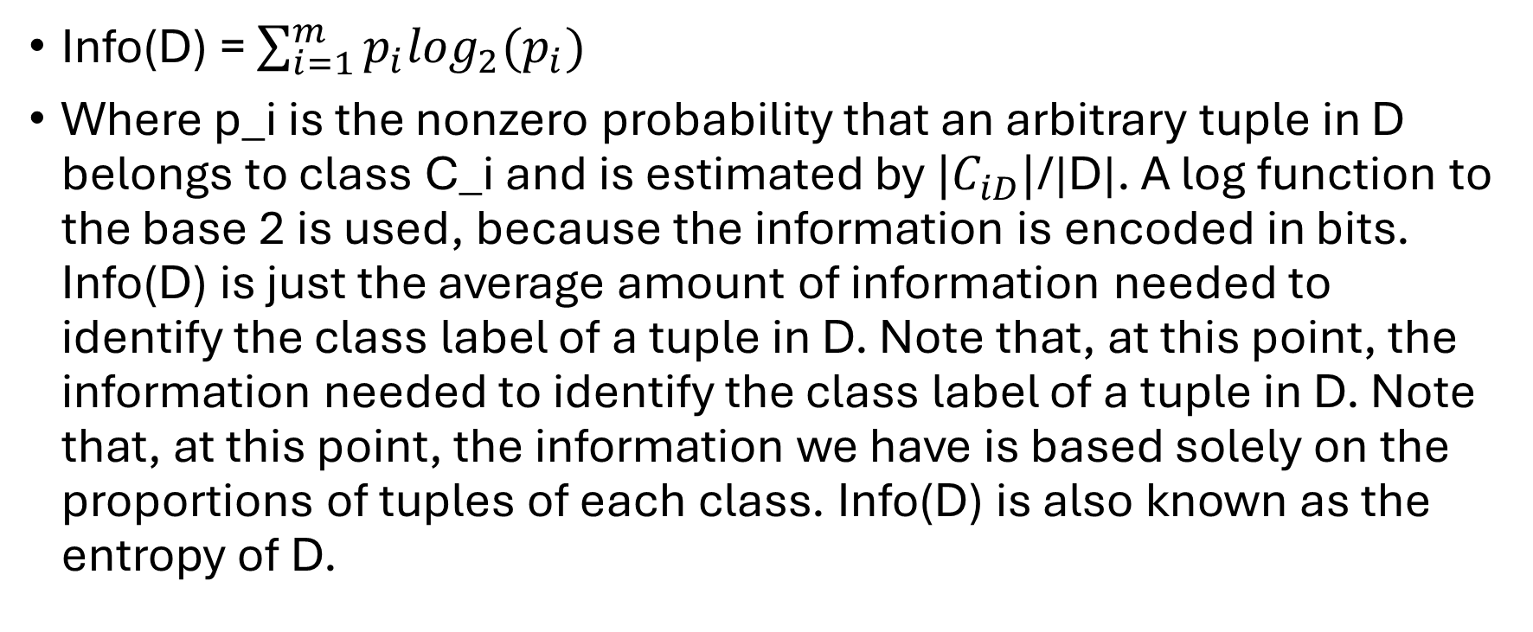
The formula to classify a tuple in D
Info(D) = $\sum_{i=1}^{m}{p_{i}\log_{2}(p_{i})}$
Where p_i is the nonzero probability that an arbitrary tuple in D belongs to class C_i and is estimated by ${|C}_{iD}|$/|D|. A log function to the base 2 is used, because the information is encoded in bits. Info(D) is just the average amount of information needed to identify the class label of a tuple in D. Note that, at this point, the information needed to identify the class label of a tuple in D. Note that, at this point, the information we have is based solely on the proportions of tuples of each class. Info(D) is also known as the entropy of D.

Slide 19
Classification impact for ID3 for information gain
Now suppose we were to partition the tuples in D on some attribute. A having v distinct values {a1, a2,…,av} as observed from the training data. If A is discrete values these values correspond directly to the v outcomes of a test on A. Attribute A can be used to split D into v partitions or subsets {D1, D2, …, Dv} where Dj contains those tuples in D that have outcome aj of A. These partitions would correspond to the branches grown from node N. Ideally we would like this partitioning to produce an exact classification of the tuples. That is, we would like for each partition to be pure. However it is quite likely that the partitions will be impure (where a partition may contain a collection of tuples from different classes rather than from a single class)

Slide 20
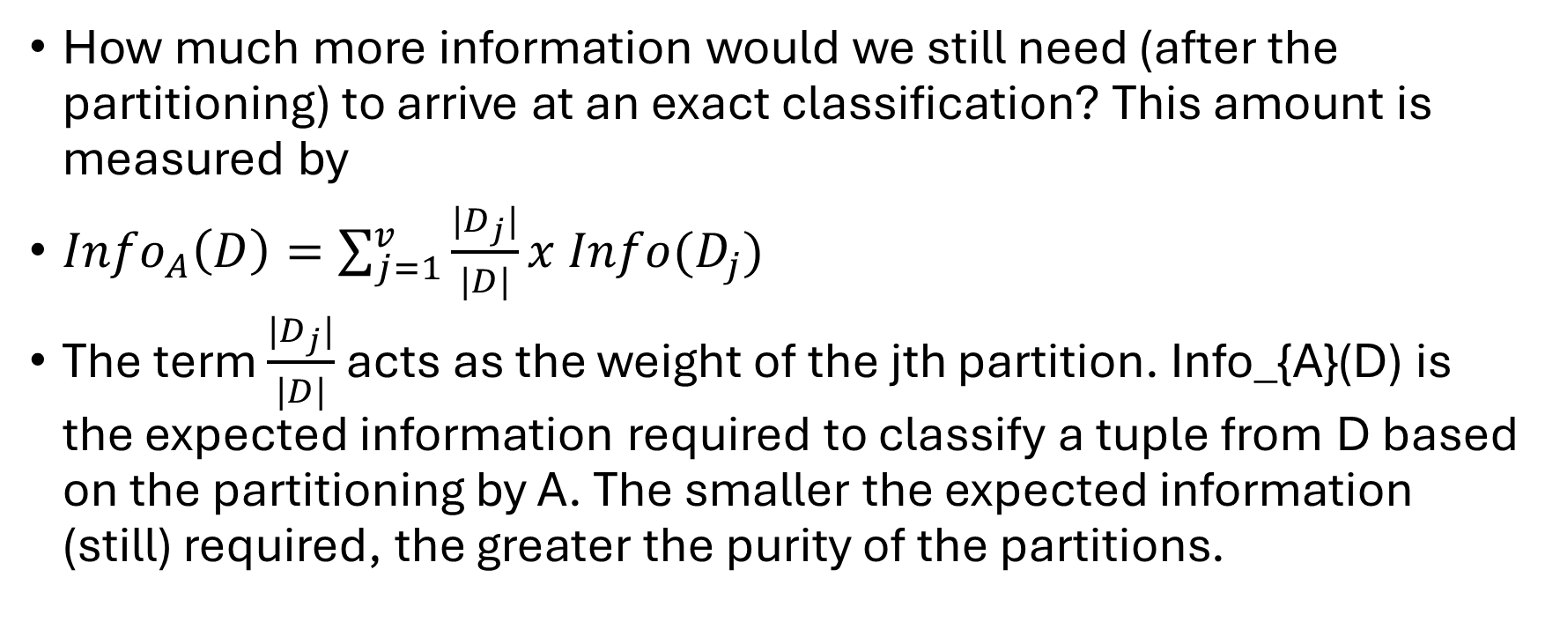
Classification impact for ID3 for information gain
How much more information would we still need (after the partitioning) to arrive at an exact classification? This amount is measured by
${Info}_{A}\left(D\right)=\sum_{j=1}^{v}{\frac{|D_{j}|}{|D|}}x Info(D_{j})$
The term $\frac{|D_{j}|}{|D|}$ acts as the weight of the jth partition. Info_{A}(D) is the expected information required to classify a tuple from D based on the partitioning by A. The smaller the expected information (still) required, the greater the purity of the partitions.

Slide 21
Information gain definition
Information gain is defined as the difference between the original information requirement (i.e. based on just the proportion of classes) and the new requirement (i.e., obtained after partitioning on A) That is
Gain(A) = Info(D) –Info_{A}(D)
In other words, Gain(A) tells us how much would be gained by branching on A. It is the expected reduction in the information requirement caused by knowing the value of A. The attribute A with the highest information gain, Gain(A), is chosen as the splitting attribute at node N. This is equivalent to saying that we want to partition on the attribute A that would do the “best” classification”, so that the amount of information still required to finish classifying the tuples in minimal (i.e., minimum Info_{A}(D).)

Slide 22
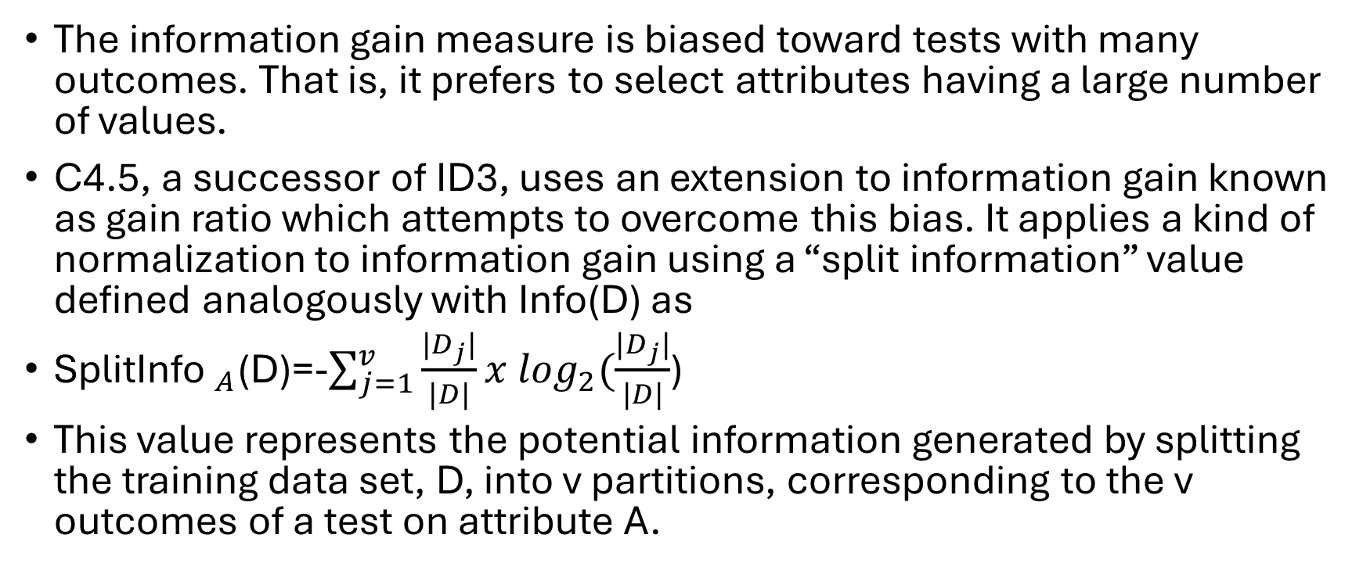
Gain Ratio
The information gain measure is biased toward tests with many outcomes. That is, it prefers to select attributes having a large number of values.
C4.5, a successor of ID3, uses an extension to information gain known as gain ratio which attempts to overcome this bias. It applies a kind of normalization to information gain using a “split information” value defined analogously with Info(D) as
${\text{SplitInfo} }_{A}$(D)=-$\sum_{j=1}^{v}{\frac{|D_{j}|}{|D|}}x \log_{2}(\frac{|D_{j}|}{|D|}$)
This value represents the potential information generated by splitting the training data set, D, into v partitions, corresponding to the v outcomes of a test on attribute A.

Slide 23
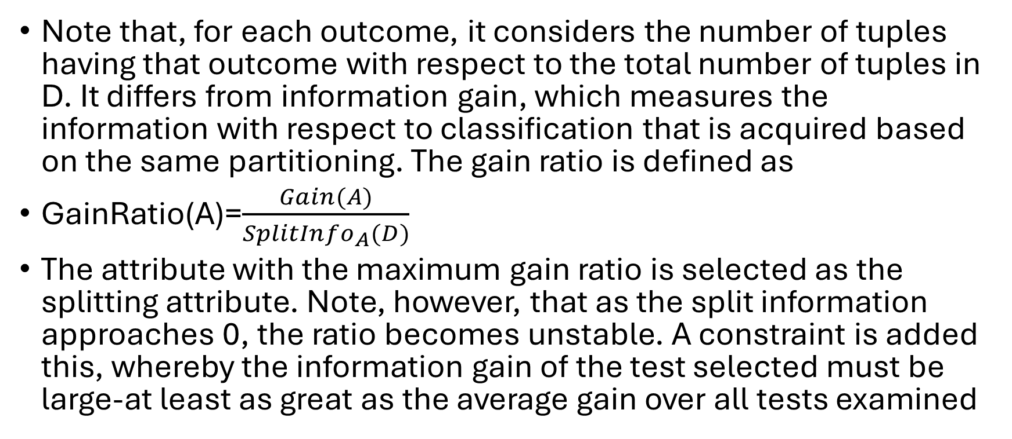
Gain ratio equation
Note that, for each outcome, it considers the number of tuples having that outcome with respect to the total number of tuples in D. It differs from information gain, which measures the information with respect to classification that is acquired based on the same partitioning. The gain ratio is defined as
GainRatio(A)=$\frac{Gain(A)}{{SplitInfo}_{A}(D)}$
The attribute with the maximum gain ratio is selected as the splitting attribute. Note, however, that as the split information approaches 0, the ratio becomes unstable. A constraint is added this, whereby the information gain of the test selected must be large-at least as great as the average gain over all tests examined

Slide 24
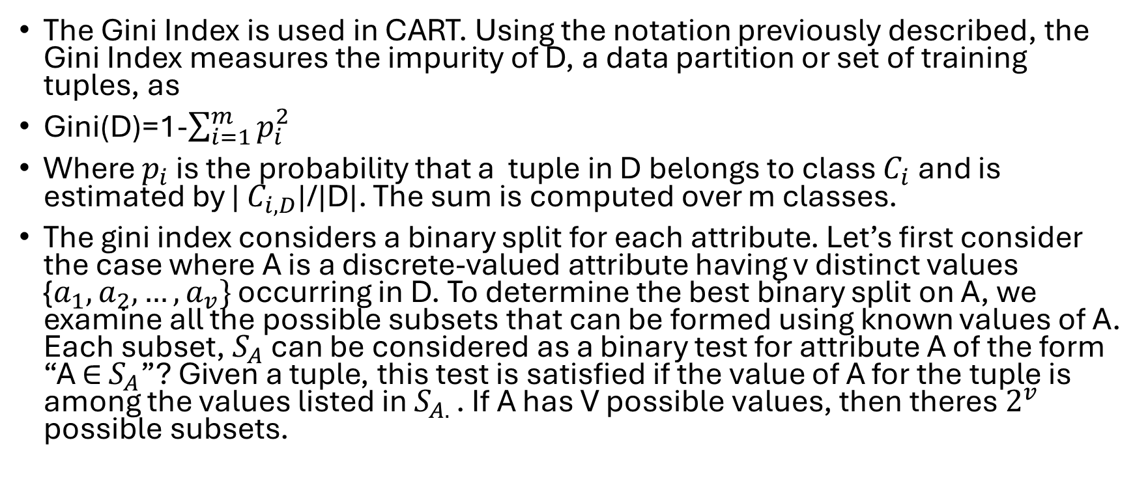
Gini Index
The Gini Index is used in CART. Using the notation previously described, the Gini Index measures the impurity of D, a data partition or set of training tuples, as
Gini(D)=1-$\sum_{i=1}^{m}{p_{i}^{2}}$
Where $p_{i}$ is the probability that a tuple in D belongs to class $C_{i}$ and is estimated by | $C_{i, D}$|/|D|. The sum is computed over m classes.
The gini index considers a binary split for each attribute. Let’s first consider the case where A is a discrete-valued attribute having v distinct values {$a_{1},a_{2},…,a_{v}\}$ occurring in D. To determine the best binary split on A, we examine all the possible subsets that can be formed using known values of A. Each subset, $S_{A}$ can be considered as a binary test for attribute A of the form “A $∈$ $S_{A}$”? Given a tuple, this test is satisfied if the value of A for the tuple is among the values listed in $S_{A. }$. If A has V possible values, then theres $2^{v}$ possible subsets.

Slide 25
Other Attribute Selection Measures
Attribute selection measures based on the Minimum Description Length (MDL) principle have the least bias toward multivalued attributes. MDL-based measures use ecoding techniques to define the “best” decision tree as the one that requires the fewest number of bits to both (1) encode the tree and (2) encode the exceptions to the tree (so cases that are not correctly classified by the tree)
Its main idea is that the simplest of solutions is preferred

Slide 26
Multivariate splits
Other attribute selection measures consider multivariate splits.
The CART system, for example, can find multivariate splits based on a linear combination of attributes are created based on the existing ones. (Attribute construction was also discussed in Chapter 3, as a form of data transformation). These other measures mentioned here are beyond the scope of this book. Additional references are given in the bibliographic notes at the end of this chapter (Section 8.9)

Slide 27
Ch 8.2.3 Tree Pruning
In the prepruning approach, a tree is “pruned” by halting its construction early (e.g., by deciding not to further split or partition the subset of training tuples at a given node).
Upon halting, the node becomes a leaf. The leaf may hold the most frequent class among the subset tuples or the probability distribution of those tuples
The second and more common approach is postpruning, which removes subtrees from a “fully grown” tree. A subtree at a given node is pruned by removing tis branches and replacing it with a leaf. The leaf is labeled with the most frequent class among the subtree being replaced.

Slide 28
8.3 Bayes Classification Methods
“What are Bayesian classifiers?” Bayesian classifiers are statistical classifiers. They can predict class membership such as the probability that a given tuple belongs to a particular class
Bayesian classification is based on Bayes theorem, described next. Studies comparing classification algorithms have found a simply Bayesian classifier known as the naïve Bayesian classifier to be comparable in performance with decision tree and selected neural network classifers. Bayesian classifiers have also exhibited high accuracy and speed when applied to large databases.

Slide 29
Bayesian Classifiers
Naïve Bayesian classifiers assume that the effect of an attribute value on a given class is independent of the values of the other attributes. This assumption is called class-conditional independence. It is made to simplify the computations involved and, in this sense is considered “naïve”.

Slide 30
Ch 8.3.1 Bayes’ Theorem
Thomas Bayes, a nonconformist English clergyman who did early work in probability and decision theory during the 18th century. Let X be a data tuple. In Bayesian terms, X is considered “evidence”. As usual, it is described by measurements made on a set of n-attributes. Let H be some hypothesis such as that the data tuple X belongs to a specified class C. For classification problems, we want to determine P(H|X), the probability that the hypothesis H holds given the “evidence” or observed data tuple X. In other words, we are looking for the probability that tuple X belongs to class C, given that we know the attribute description of X.

Slide 31
Posterior probability
P(H|X) is the posterior probability, or a posteriori probability of H conditioned on X. For example, suppose our world of data tuples is confined to customers described by the attributes age and income, respectively, and that X is a 35-year-old customer with an income of $40,000. Suppose that H is the hypothesis that our customer will buy a computer. Then P(H|X) reflects the probability that customer X will buy a computer given that we know the customers age and income

Slide 32
Prior porbability
In contrast P(H) is the prior probability, or a priori probability, of H.
For our example, this is the probability that any given customer will buy a computer, regardless of age, income, or any other information, for that matter. The posterior probability P(H|X), is based on more information (e.g. customer information) than the prior probability P(H), which is independent of X
Similarly, P(X|H) is the posterior probability of X conditioned on H. That is, it is the probability that a customer X, is 35 years old and earns $40,000, given that we know the customer will buy a computer
P(X) is the prior probability of X. Using our example, it is the probability that a person from our set of customers is 35 years old and earns $40,000.

Slide 33
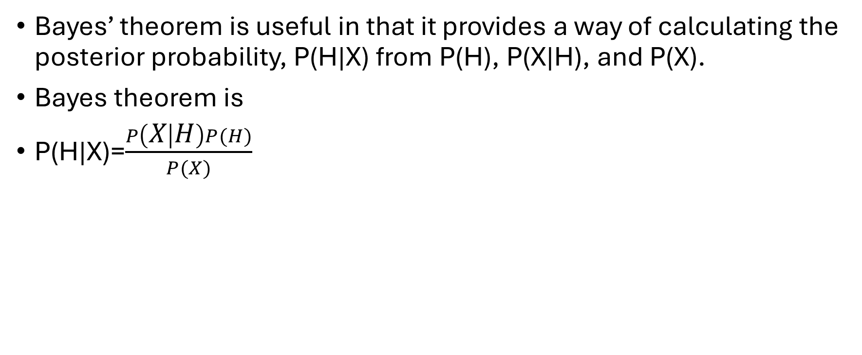
Bayes Theorem
Bayes’ theorem is useful in that it provides a way of calculating the posterior probability, P(H|X) from P(H), P(X|H), and P(X).
Bayes theorem is
P(H|X)=$\frac{P\left(X | H\right)P(H)}{P(X)}$

Slide 34
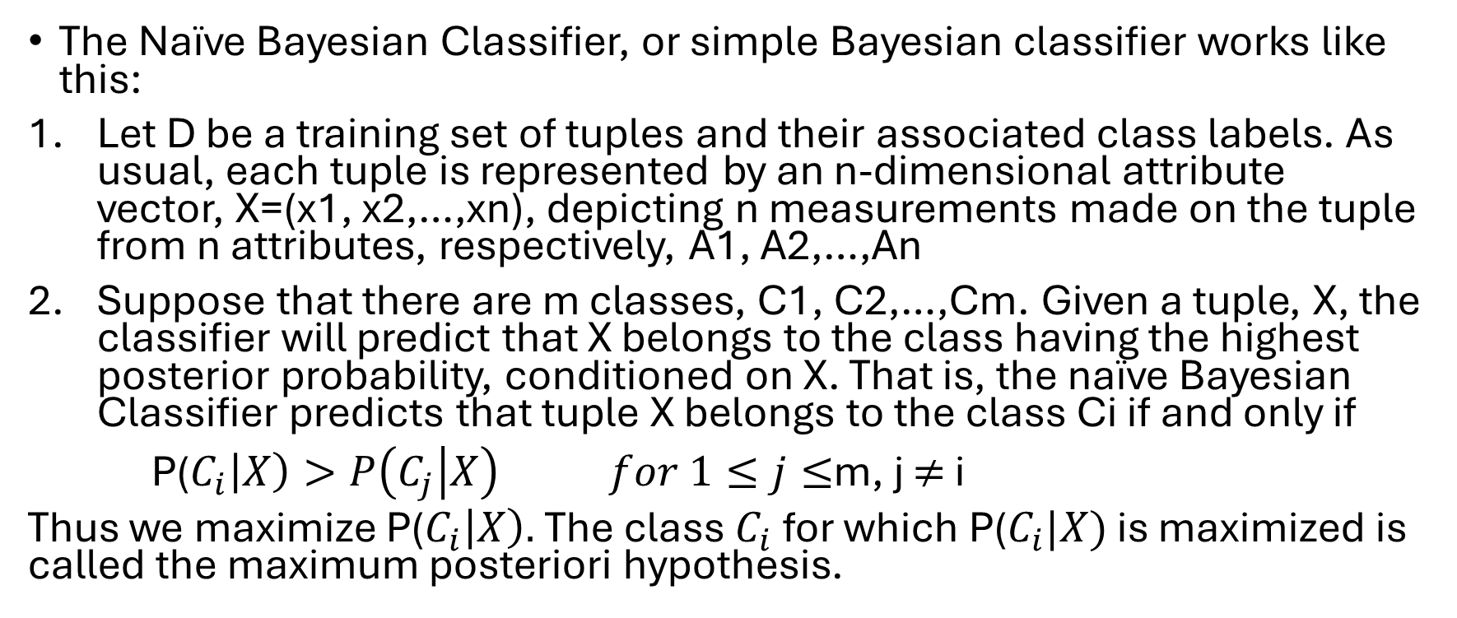
Ch 8.3.2 Naïve Bayesian Classification
The Naïve Bayesian Classifier, or simple Bayesian classifier works like this:
Let D be a training set of tuples and their associated class labels. As usual, each tuple is represented by an n-dimensional attribute vector, X=(x1, x2,…,xn), depicting n measurements made on the tuple from n attributes, respectively, A1, A2,…,An
Suppose that there are m classes, C1, C2,…,Cm. Given a tuple, X, the classifier will predict that X belongs to the class having the highest posterior probability, conditioned on X. That is, the naïve Bayesian Classifier predicts that tuple X belongs to the class Ci if and only if
P($C_{i}\left|X\right)>P\left(C_{j} | X\right) for 1≤j≤$m, j $≠$ i
Thus we maximize P($C_{i}\left|X\right).$The class $C_{i}$ for which P($C_{i}|X)$ is maximized is called the maximum posteriori hypothesis.

Slide 35
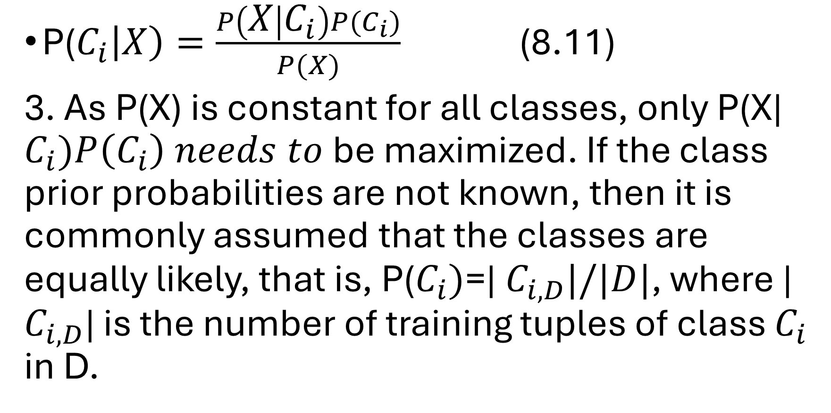
Bayes Theorem
P($C_{i}\left|X\right)=\frac{P\left(X | C_{i}\right)P(C_{i})}{P(X)}$ (8.11)
3. As P(X) is constant for all classes, only P(X| $C_{i})P\left(C_{i}\right) needs to$be maximized. If the class prior probabilities are not known, then it is commonly assumed that the classes are equally likely, that is, P($C_{i})$=| $C_{i, D}|/|D|$, where | $C_{i, D}$| is the number of training tuples of class $C_{i}$ in D.

Slide 36
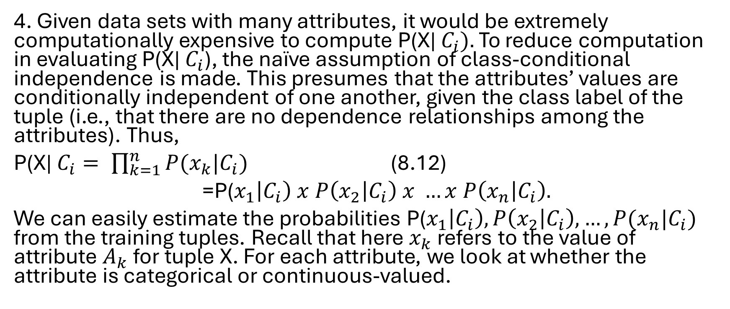
4. Given data sets with many attributes, it would be extremely computationally expensive to compute P(X| $C_{i}).$ To reduce computation in evaluating P(X| $C_{i}$), the naïve assumption of class-conditional independence is made. This presumes that the attributes’ values are conditionally independent of one another, given the class label of the tuple (i.e., that there are no dependence relationships among the attributes). Thus,
P(X| $C_{i}= \prod_{k=1}^{n}{P(x_{k}|C_{i})}$ (8.12)
=P($x_{1}\left|C_{i}\right) x P\left(x_{2} | C_{i}\right) x …x P\left(x_{n} | C_{i}\right).$
We can easily estimate the probabilities P($x_{1}\left|C_{i}\right), P\left(x_{2} | C_{i}\right),…,P(x_{n}|C_{i})$ from the training tuples. Recall that here $x_{k}$ refers to the value of attribute $A_{k}$ for tuple X. For each attribute, we look at whether the attribute is categorical or continuous-valued.

Slide 37
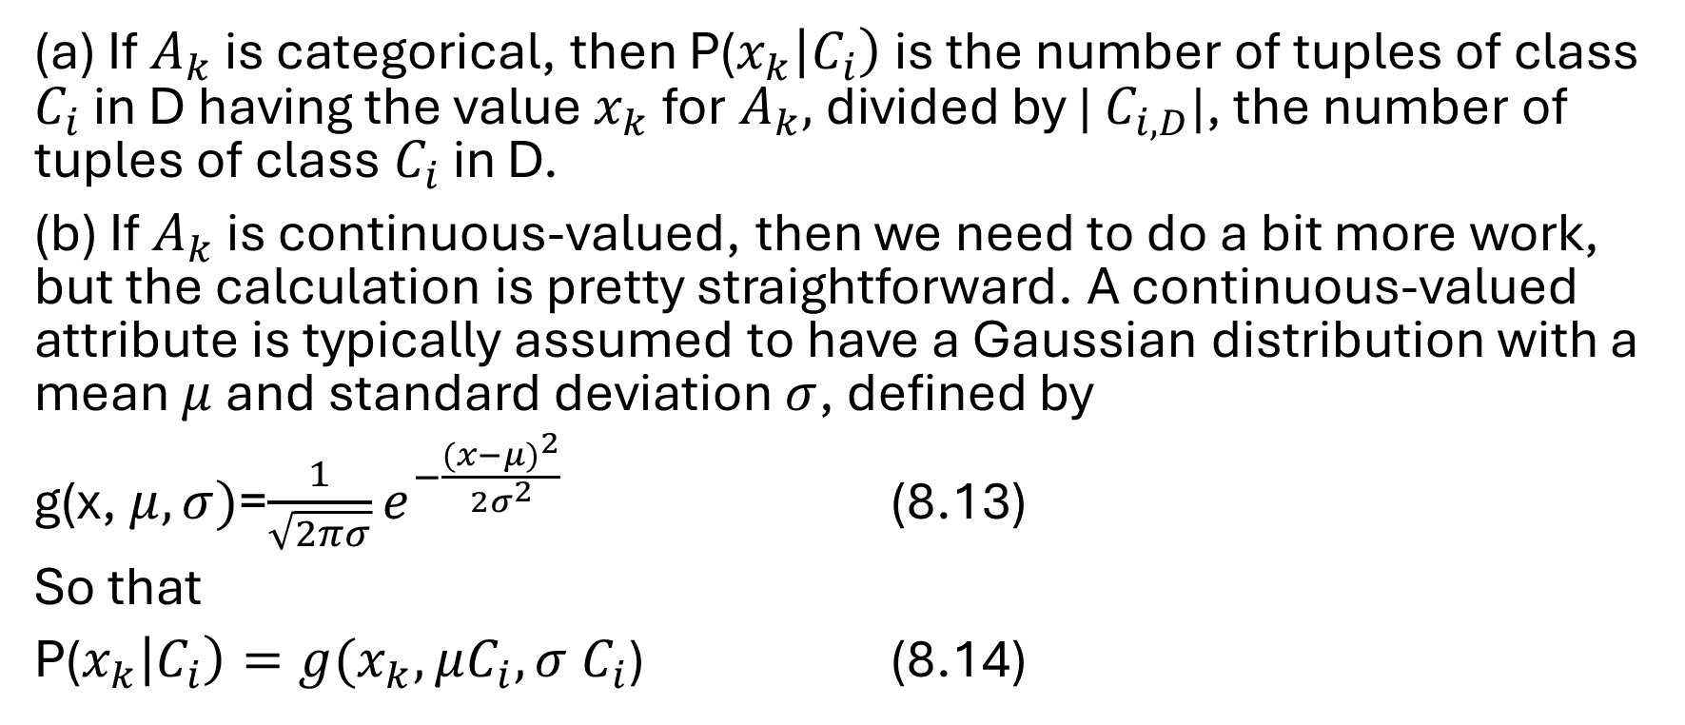
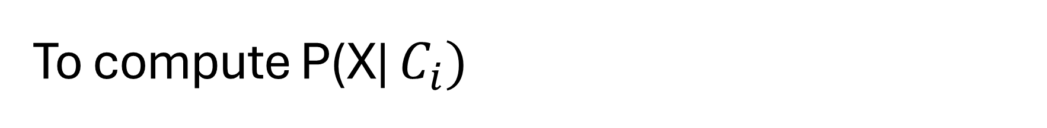
To compute P(X| $C_{i})$
(a) If $A_{k}$ is categorical, then P($x_{k}\left|C_{i}\right)$ is the number of tuples of class $C_{i}$ in D having the value $x_{k}$ for $A_{k},$divided by | $C_{i, D}$|, the number of tuples of class $C_{i}$ in D.
(b) If $A_{k}$ is continuous-valued, then we need to do a bit more work, but the calculation is pretty straightforward. A continuous-valued attribute is typically assumed to have a Gaussian distribution with a mean $μ$ and standard deviation $σ$, defined by
g(x, $μ, σ)$=$\frac{1}{\sqrt{2πσ}}e^{−\frac{{(x−μ)}^{2}}{{2σ}^{2}}}$ (8.13)
So that
P($x_{k}\left|C_{i}\right)=g(x_{k}, μC_{i}, σ$ $C_{i}$) (8.14)

Slide 38

These equations may appear daunting, but hold on! We need to compute $μ$ $C_{i}$ and $σ$ $C_{i}$, which are the mean (i.e., average) and standard deviation, respectively, of the values of attribute $A_{k}$ for training tuples of class $C_{i}$. We then plug these two quantities into Eq. (8.13) together with $x_{k}$ to estimate P($x_{k}$| $C_{i})$.

Slide 39
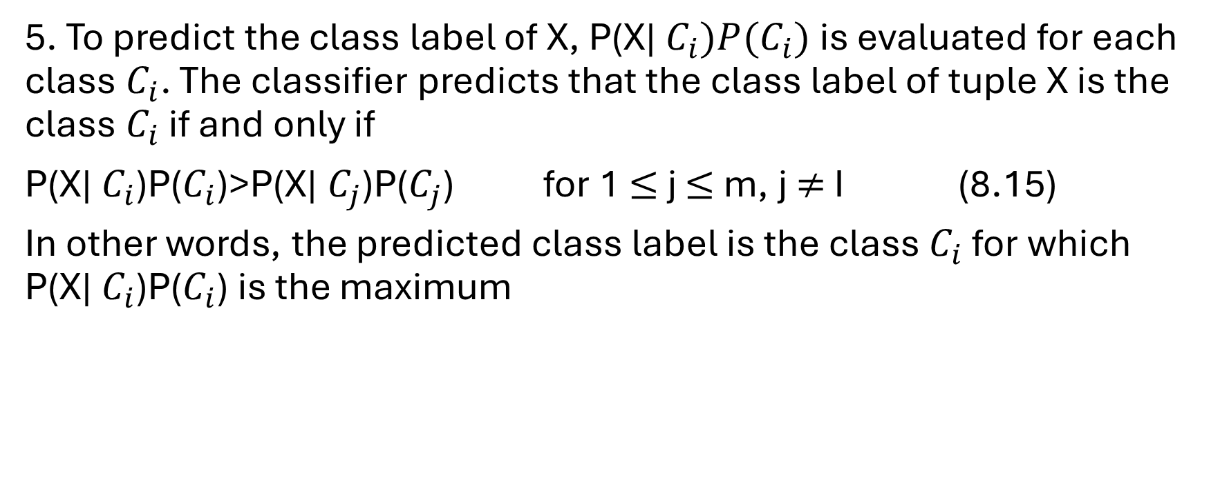
Last part of Bayes Theorem
5. To predict the class label of X, P(X| $C_{i})P(C_{i})$ is evaluated for each class $C_{i}$. The classifier predicts that the class label of tuple X is the class $C_{i}$ if and only if
P(X| $C_{i}$)P($C_{i}$)>P(X| $C_{j}$)P($C_{j}$) for 1 $≤$ j $≤$ m, j $≠$ I (8.15)
In other words, the predicted class label is the class $C_{i}$ for which P(X| $C_{i}$)P($C_{i}$) is the maximum

Slide 40
Bayesian Classifiers discussion
“How effective are Bayesian classifiers?” Various empirical studies of this classifier in comparison to decision tree and neural network classifiers have found it to be comparable in some domains. In theory, Bayesian classifiers have the minimum error rate in comparison to all other classifiers. However, in practice this is not always the case, owing to inaccuracies in the assumptions made for its use, such as class-conditional independence, and the lack of available probability data.
Bayesian classifiers are also useful in that they provide a theoretical justification for other classifiers that do not explicitly use Bayes’ theorem. For example, under certain assumptions, it can be shown that many neural network and curve-fitting algorithms output the maximum posteriori hypothesis, as does the Naïve Bayesian classifier.

Slide 41
Ch 8.4 Rule-Based Classification
A rule-based classifier uses a set of IF-THEN rules for classification.
An IF-THEN rule is an expression of the form
IF condition THEN conclusion
The “IF” part is knonw as the rule antecedent or precondition.
The “THEN” part is the rule consequent. If the rule antescedent, the condition consists of one or more attribute tests

Slide 42
Ch 8.5 Model Evaluation and Selection
We can talk in terms of positive tuples (tuples of the main class of interest)
And negative tuples (all other tuples)
True positives (TP): These refer to the positive tuples that were correctly labeled by the classifier, Let TP be the number of true positives
True negatives (TN): These are the negative tuples that were correctly labeled by the classifier, let TN be the number of true negatives
False positives (FP): These are the negative tuples that were incorrectly labeled positive (e.g. tuples of class buys_computer = no for which the classifier prediceted buys_computer = yes). Let FP be the number of false positives
False negatives (FN): These are the positive tuples that were mislabeled as negative (eg tuples of class buys_computer – yes for which the classifier predicted buys_computer = no). Let FN be the number of false negatives

Slide 43
Ch 8.6 Techniques to Improve Classification Accuracy
Bagging, boosting, and random forests are examples of ensemble methods
Bagging is when you are given a set D, and d tuples, bagging works as follows. For iteration i(i=1,2,…,k), a training set Di, of d tuples is sampled with replacement from the original set of tupels D. The term bagging stands for bootstrap aggregation. Each training set is a bootstrap sample.

Slide 44
Boosting and AdaBoost
In boosting weights are also assigned to each training tuple. A series of k classifiers is iteratively learned. After a classifier, Mi, is learned, the weights are updated to allow the subsequent classifier M{i+1} to “pay more attention” to the training tuples that were misclassified by Mi. The final boosted classfier M* combines the votes of each individual classifier, where the weight of each classfiiers vote is a function of its accuracy.
AdaBoost (short for Adaptive Boosting) is a popular boosting algorithm. Suppose we want to boost the accuracy of a learning method. We are given D, a data set of d class-labeled tuples, (X1, y1), (X2,y2),…,(Xd,yd) where yi is the class label of tuple Xi.

Slide 45
Random Forests
Imagine that each of the classifiers in the ensemble is a decision tree classifier so that the collection of classifiers is a “forest”. The individual decision trees are generated using a random selection of attributes at each node to determine the split. More formally, each tree depends on the values of a random vector sampled independently and with the same distribution for all trees in the forest. During classification, each tree votes and the most popular class is returned.

Slide 46
Ch 8.6.5 Improving Classification Accuracy of Class-Imbalanced Data
Oversampling works by resampling the positive tuples so that the resulting training set contains an equal number of positive and negative tuples
Under sampling works by decreasing the number of negative tuples. It randomly eliminates tuples from the majority (negative) class until there are an equal number of positive and negative tuples

